Slide 1
Making this resource work for you
Prior to teaching this lesson, please refer to the ‘Unit Overview and Planning Document’.
Further guidance on planning Science Mastery lessons can be found in the detailed planning guidance document.
Refer to the ‘notes’ section on each slide for useful information, including suggested expositions, pedagogical content knowledge, suggested questions, answers and more. Consider using presenter mode so you can see this guidance throughout the lesson.
The introduction slides can be adapted to suit your teaching style and the needs of your class.
Before the lesson, adapt the fix-it slide to address any misconceptions identified in the previous lesson’s exit ticket.
Choose from the suggested activities to suit your class. The intention is not that you complete all of these, but that you select those which ones are most appropriate for your students. It may be appropriate to further adapt activities for your students.
These lessons are designed to occupy approximately 1 hour. To adapt for a shorter or longer lesson duration we advise you to adapt the activity section accordingly.
Please consider using the final slide to send feedback about this lesson or examples of PowerPoints that you have adapted to our design team. Your feedback is used to improve Science Mastery for all of our teachers and students. We appreciate all suggestions and comments.
Thank you for reading!
The Science Mastery Team

Slide 2

Feedback Lesson
Do Now:
State the name of the positive electrode in electrolysis.
List the ions in molten beryllium oxide.
Why do ionic substances need to be melted or dissolved for electrolysis to work?
What ions does water form?
Explain the difference between renewable and non-renewable energy resources.
The positive electrode is the anode.
Be²⁺ and O²⁻.
So that the ions can move and carry charge through the electrolyte.
H⁺ ions and OH⁻ ions
Renewable energy resources can be replenished as they are used but non-renewable resources cannot.

Slide 3
Feedback Lesson
Do Now:
State the name of the positive electrode in electrolysis.
List the ions in molten beryllium oxide.
Why do ionic substances need to be melted or dissolved for electrolysis to work?
What ions does water form?
Explain the difference between renewable and non-renewable energy resources.
Drill:
State the SI unit of energy.
State the SI unit of power.
State the equation used to calculate gravitational potential energy.
Notes:
Answers:
Do Now:
1. The positive electrode is the anode.
2. Be²⁺ and O²⁻.
3. So that the ions can move and carry charge through the electrolyte.
4. H⁺ ions and OH⁻ ions
5. Renewable energy resources can be replenished as they are used but non-renewable resources cannot.

Slide 4

C4.2.16
29/09/2023
Feedback Lesson
C4.2.1 PKR: Reactions of Metals
C4.2.2 Extracting Less Reactive Metals
C4.2.3 PKR: Ions, Ionic Bonding and Deducing Ionic Formulae
C4.2.4 (HT) Ionic Equations and Displacement Reactions
C4.2.5 (HT) Writing Half Equations
C4.2.6 (HT) Ionic Equations for the Reactions of Acids and Metals
C4.2.7 Introduction to Electrolysis
C4.2.8 Extracting Metals by Electrolysis
C4.2.9 Electrolysis of Molten Ionic Compounds
C4.2.10 Electrolysis in Solutions
C4.2.11 RP: Electrolysis of Aqueous Solutions
C4.1.12 RP: Electrolysis of Aqueous Solutions
C4.1.13 TIF: Corrosion and its Prevention
C4.2.14 (HT) Obtaining Raw Materials
C4.2.15 Recycling Metals
C4.2.16 Feedback Lesson
Notes:
Big Idea: Reactions Rearrange Matter
Suggested Hook: Ask for a show of hands from students. How many of them recycle? Discuss: What do they recycle? Why?

Slide 5

Following this lesson, students will be able to:
[Teacher to edit objectives based on mastery quiz outcomes]
[Teacher to edit objectives based on mastery quiz outcomes]
[Teacher to edit objectives based on mastery quiz outcomes]
Key Words:
electrolysis
electrolyte
half equation
ionic equation
phytomining
Notes:
Copy this slide for Feedback Lesson

Slide 6
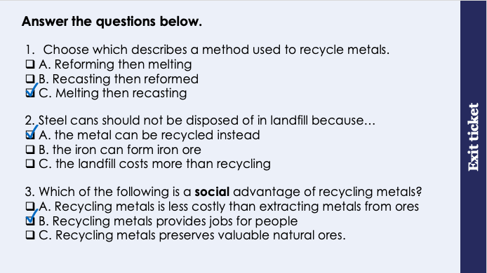
This is the fix-it portion of the lesson
The fix-it is an opportunity to respond to gaps in knowledge, especially those identified by the previous lesson’s exit ticket.
The teacher should customise this slide as needed, to facilitate
reteach, explanation, demonstration or modelling of ideas and concepts that students have not yet grasped or have misunderstood.
practise answering specific questions or of key skills.
redrafting or improving previous work.
Notes:
Fix it guidance from previous lesson:
Q1. Answer: C
If students answer A or B, they are missing up the words used to describe the recycling of metals. To fix-it, ask students to define the melting and recasting of metals.
Q2. Answer: A
If students answer B or C, they cannot describe the advantage of recycling a metal. To fix-it, ask students to describe the advantages of recycling a metal with a list.
Q3. Answer: B
If students answer A or C, they are unable to differentiate between a social, environmental or economic advantage. To fix-it, gibe students a list of statements to classify as social, environmental or economic related. You may want to define these words for students beforehand.

Slide 7
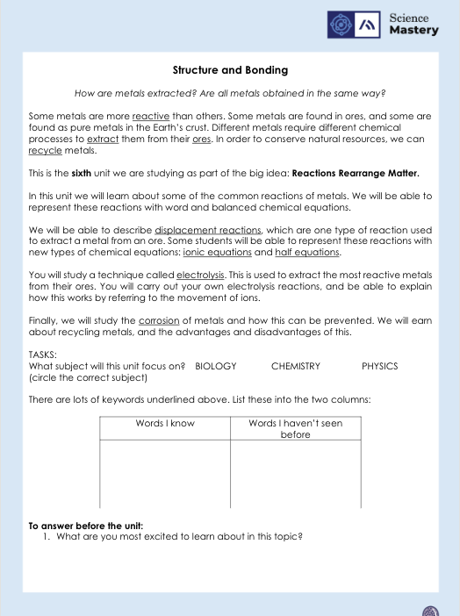
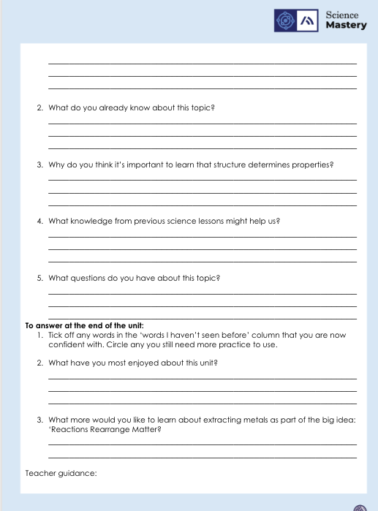
The Big Idea: Reactions Rearrange Matter
Notes:
Purpose:. The purpose of this resource is to provide students with an overview at the beginning and end of each unit. It is designed to create a discussion about the unit prior to and at the end of the sequence of lessons.
Teacher guidance:
Pupils should be directed to the C4.2 Link to Big Ideas worksheet (either in their booklet or printed). This may be back at the beginning of the sequence of lessons.
Teachers should use guided reading techniques to read aloud with the pupils and then pupils should answer the reflection questions. This could be used to summarise what pupils have learnt.
Questions on the student sheet:
1. Tick off any words in the ‘words I haven’t seen before’ column that you are now confident with. Circle any you still need more practice to use.
2. What have you most enjoyed about this unit?
3. What more would you like to learn about particles as part of the big idea: ‘Characteristics are Inherited’?
There are a range of ways to use this resource:
1. Display on a slide for students to read as a class. Direct students to complete the activities in their book.
2. Print off for students to stick into their book at the beginning of the unit along with their knowledge organiser. Complete as a guided reading task together. Direct students to complete the activities.
3. Have students complete as part of a booklet.
Set as a homework to reflect on the unit.
If you have any feedback about how this resource could be used/improved, please contact the science mastery team: sciencemastery@arkonline.org

Slide 8
Answers
Can you explain why your answer was wrong?
Question | Answer
1
2
3
4
5
6
7
8
9
10
11
Question | Answer
12
13
14
15
16 (HT)
17 (HT)
18 (HT)
19 (HT)
20 (HT)
21 (Chemistry only)
22 (Chemistry only)
B
C
B
C
B
A
A
A
B
A
C
B
B
C
A
A
A
A
A
C
B
C
Notes:
Purpose: for students to correct their answers so they can see where they made errors and have a corrected quiz stuck in their books
Suggested guidance: talk through each question and cold call students to explore why the incorrect options are wrong. Students should write annotations on their marked quiz so they can revise from it.

Slide 9
Answers
1. 2+ [1]
2.
It has gained electrons [1]
3.
Gold is very unreactive [1]
(so it found as pure metal in the Earth because it )will not easily react with other substances [1]
Notes:
Purpose: for students to correct their answers so they can see where they made errors and have improved their Section B answers.
Suggested guidance: talk through each question and cold call students to explore why the incorrect options are wrong. Students should write annotations on their marked quiz so they can revise from it.

Slide 10
Answers
4.
Magnesium ions (in the molten magnesium chloride) [1]
are attracted to the negative electrode/cathode (because they are positively charged). [1]
(At the negative electrode,) magnesium ions gain electrons [1]
Or
are reduced
2 electrons are gained [1]
(HT only) Allow 3 marks for the correct half equation
Mg²⁺ + 2e⁻ → Mg (HT only)

Slide 11
Answers
5.
Phytomining [1]
uses plants to absorb metal compounds [1]
(The plants are harvested and) then burned to produce ash that contains metal compounds [1]
Bioleaching [1]
uses bacteria [1]
to produce leachate solutions (that contain metal compounds) [1]

Slide 12
Answers
6.
Zn → Zn²⁺ + 2e⁻ [1]
2H⁺ + 2e⁻ → H₂ [1]
7. Chemistry only
By reacting with substances in the environment. [1]

Slide 13
Complete your fix it task
Teacher to edit according to class performance on quiz
If you got any of QX wrong
Insert fix-it task instructions here. See the mastery quiz mark scheme for suggested fix-it tasks.
If you got any of QX wrong…
Insert fix-it task instructions here. See the mastery quiz mark scheme for suggested fix-it tasks.
If you got QX or QX wrong …
Insert fix-it task instructions here. See the mastery quiz mark scheme for suggested fix-it tasks.
Notes:
Some suggested fix-it activities:
If you got Q1, Q2, Q3, or Q6 wrong…
Label the rock cycle diagram and complete the cloze activity worksheet
If you got Q4 wrong…
Watch the videos on salol cooling and complete the igneous rock worksheet again
If you got Q5 wrong…
Make a table with two columns. One for Weathering and one for erosion. Use the PowerPoint slides on weathering and erosion to put examples of each into your table.
If you got Q7, Q8, or Q9 wrong…
Draw and label the water cycle using red arrows to show water moving into the atmosphere and blue to show water moving out of the atmosphere. Use your notes to help you.
If you got Q10 wrong…
List the ways water can leave our bodies and explain why A and B are incorrect.

Slide 14
Lesson C4.2.16
What was good about this lesson? | What can we do to improve this lesson?
Send us your feedback by clicking this link
or by emailing sciencemastery@arkonline.org
Thank you!

